Slide 1
Broom Solutions: Technical Presentation
Team 4
Anthony Buti
Bogdan Constantinescu
Daniel Lee
Mason Mackall
Jorge Arias Serrato

Slide 2






Business Problem
Broom Solution's current fraud detection technology is declining an unacceptable number of legitimate transactions
Our consultant team's approach is to implement an automated feature-engineering fraud detection solution that will be customizable to the spending habits of each of Broom's customers
Our solution will significantly reduce the number of false positives and ensure that Broom's customers are never prevented from seizing an opportunity to create a satisfied customer
These false positives have caused Bloom's customers and Broom's reputation to suffer

Slide 3
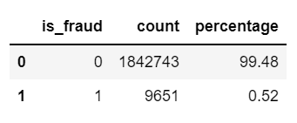
Exploratory Data Analysis
Dataset Size:
1.85M records
21 features, 1 target variable
Data Quality
No missing values
Highly imbalanced target:
Unique Values:
14 transaction categories
~ 1000 customers Age: 14 to 96 yrs., (50% 33 to 57 yrs.)
~ 500 job categories
~ 700 merchants
Fraud Highlights
Top 3 states: NY, TX, PA
Top months: DEC and JAN
Amounts: $250-$400 and $600-$1200

Slide 4
Feature Engineering
A. One hot encoding for categorical variables:
Gender
Transaction Category
Day-of-week
B. Creation of Historic Variables
Fraud transaction's Hour-of-Day
Fraud transactions in last 2 hrs.
Fraud transactions in the last 24 hrs.
Fraud transactions in the last 60 days

Slide 5
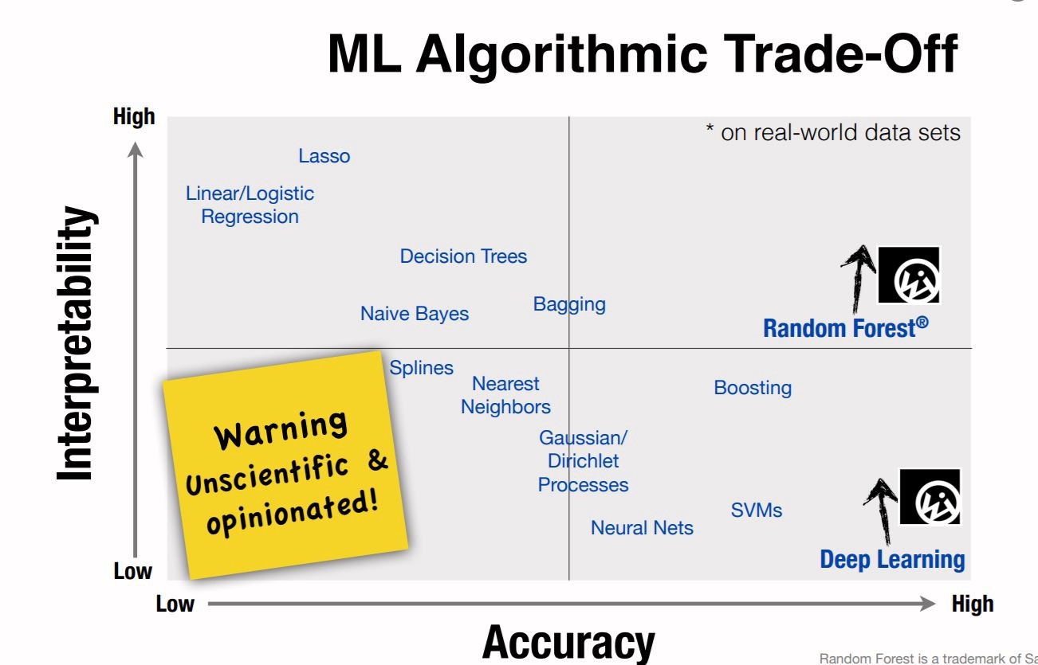
Model Selection

Slide 6
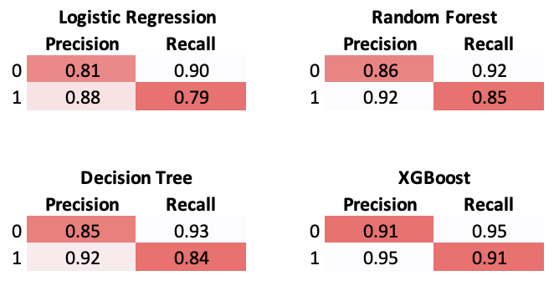
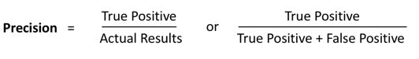
Performance Metrics
XGBoost is the model that best addresses our main issue, high number of False Positives
An increase in Precision will tell us if the algorithm performance improved
False Positive number will decrease by doing ”automated feature engineering”
Utilize MIT’s Deep Feature Synthesis (DFS) approach that extracts highly detailed features. Model has proven to reduce False Positives by 54%
The model can combine features and find patterns
https://news.mit.edu/2018/machine-learning-financial-credit-card-fraud-0920

Slide 7
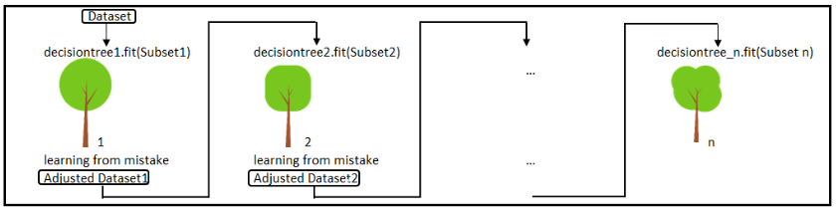
Gradient Boosting Decision Tree Model (XGBoost)
Decision Tree Learning Model
builds upon iteratively asking questions to partition data and reach a solution.
Gradient Boosting
Sequentially combines up many weak learners, filters out the good observations at every step
Results into one strong learner
Advantages:
Intuitive
Interpretable
Disadvantages:
Prone to overfitting
Parameters
learning rate: 0.1 estimators: n=100 depth d=5

Slide 8
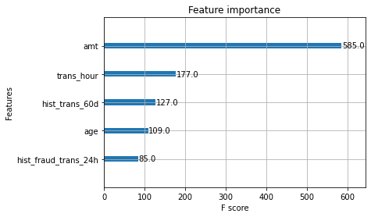
Feature Importance Determined by XGBoost
Consider:
Transaction Amount
Transaction hour-of-day

Slide 9
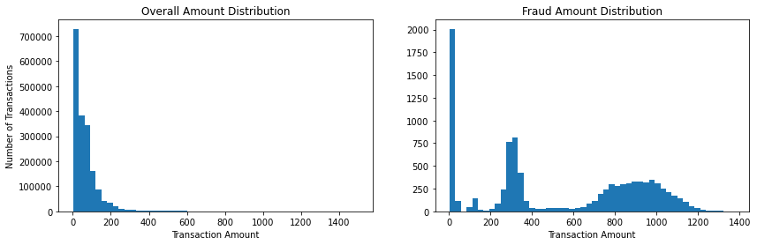
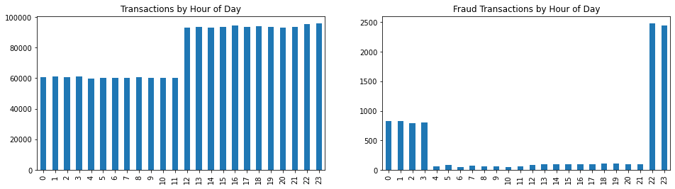
Patterns of Fraudulent Transactions

Slide 10
Economic Value
A. Improved Customer Experience
Convenience is top priority.
Reducing the amount of false-positive flags on legitimate transactions will improve customer trust and customer loyalty
2017 survey by McKinsey states that less than half of customers were satisfied with security and convenience [1].
Customers were frustrated about non-fraudulent transactions being denied frequently.
B. Tangible Monetary Value
Loyalty and enhanced customer experience translates to more transactions and more revenue.
Correctly marking transactions will reduce the load on customer support and cut down on the need for manual intervention.
Value can be recovered from good transactions that would have been declined in the old system.
[1] https://www.mckinsey.com/industries/financial-services/our-insights/fraud-management-recovering-value-through-next-generation-solutions

